Slide 1
Computational Chemistry

Slide 2
The Schrödinger equation
This is not a limit of your understand, the amount of time I have to teach you, or UMBC’s computational facilities. It’s literally impossible to solve the Schrodinger equation for atoms with more than one electron.
If we know where all the electronic structure exactly, we can calculate a variety of molecular properties
The Schrodinger equation is only exactly solvable for 1 electron
Bond lengths and angles
Spectra at a variety of wavelengths
Enthalphy of reaction
Reaction pathways

Slide 3
Electronic structure calculations
We have a series of approximations that guide our development: HF-SCF, perturbation theory, the variational principle
We can do iterative solving: guess an electron distribution, calculate effects, move electronics, try again
'ab initio' means from first principles. It doesn't use experimental data
Semi-empirical brings in data from, say, spectra, to simplify the math
It is mind boggling to read the history of quantum chemistry

Slide 4

A caution
We’re not going to worry about every detail. You can take a grad level course or join Dr. Bennett’s lab.
You need to know what types of choices can be made and where you’re vulnerable to mess things up.

Slide 5
Methods
Molecular orbital-based
Density-functional based
Use a self-consistant field algorithm to iteratively approach a set of molecular orbitals
Can use perturbation theory to account for electron-electron repulsion (correlation)
The ground state energy is a function of the electron distribution
Basically, you cast the regular MOs into a new space (called Kohn-Sham orbitals) where the math is easier
Folds in correlation naturally

Slide 6
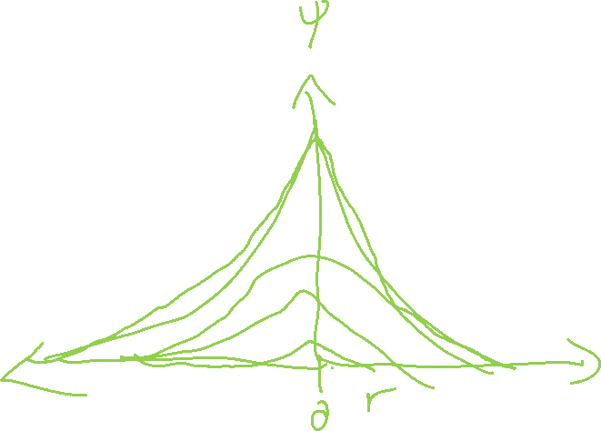
Basis sets
You have to pick your orbital representation
Real orbitals are computationally crap
We usually use a linear combination of Gaussians to approximate real ones
As you increase the number of functions used to describe an orbital
You get more accurate results
You allow for higher order results
Your computation takes longer

Slide 7

The flowchart
The choices you need to make
Method
Basis set
MO
DFT
SCF
MP2
CC
No one really knows (jk)
Plane wave
Atom centered
Slater
Gaussian
STO-3G
6-31g**

Slide 8
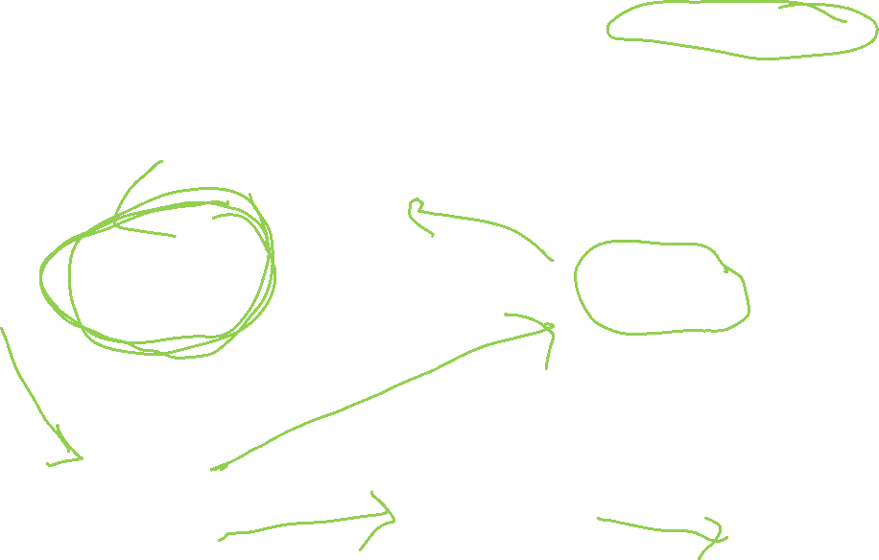
Traditional workflow
Define a molecule
Guess wavefunction
Calculate energy
Has the energy converged?
Yes
Is the geometry stable?
Yes
Plaintext list of atoms and coordinates
You have the geometry, energy, and wavefunctions
Calculate additional properties as needed
No: adjust electron distribution
No: adjust nuclei location

Slide 9


Our software stack
Work in
Work in Jupyter notebooks
Use
Use a Jupyterhub hosted by ChemCompute
Run
Run Psi4 to do the quantum chemistry calculations
Open
Open source, primarily NSF funded, free to the user

